Slide 1
~1 year, ~∞* possibilities
Elliot’s 2nd project!
*±∞

Slide 2

Overarching goals:
Grant applications
Pick some paths on the career skill tree
Time management
Research synthesis
Project management
Remote sensing expertise
Evolutionary biology expertise
Science communication and outreach
Data management
Conservation ecology expertise
Policy proposals
Scientific writing
Teaching
Supervision
Working with collection specimens
Being a good person

Slide 3
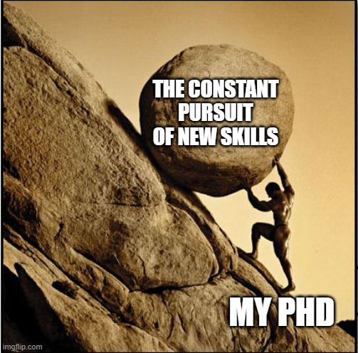
Gaining XP
Which skills to focus on?
How to attain them
Skills which align with my career goals
Skills which align with my strengths
Development of a framework to track XP and skill progression

Slide 4
Immediate goal:

